Slide 1
AI Powered Code Reviewer & Quality Assistant
Project Submitted By: DADI KAVYA SRI Course: Artificial Intelligence Mentor: Megha Institution: Narasaraopeta Engineering College Year: 2026

Slide 2
Introduction
This project is an AI-based Python Code Reviewer system designed to automatically analyze and evaluate the quality of Python programs.
In software development, writing working code is not enough. The code must be clean, readable, maintainable, and follow proper coding standards. Manual code reviews take time and may miss some issues.
To solve this problem, this system performs automated static code analysis. It checks the structure, complexity, and rule violations in the code and generates a detailed report with severity levels and quality score.

Slide 3
Problem Statement & Objectives
Problem Statement
Manual code review is:
Time-consuming
Error-prone
Inconsistent
Developers need an automated system to review code efficiently.
Objectives
Analyze Python code automatically
Detect common coding issues
Measure cyclomatic complexity
Classify issues (Info, Warning, Critical)
Generate score and grade
Provide user-friendly web interface

Slide 4
System Architecture
The system consists of two main components:
Backend (backend.py)
Parses Python code using AST
Detects issues
Calculates complexity
Applies rule engine
Generates score and CSV report
Frontend (frontend.py)
Built using Streamlit
Provides file upload option
Displays issues and summary
Allows issue review
Backend performs analysis, and frontend displays results.

Slide 5
Code Analysis & Complexity Calculation
The system uses Python’s AST (Abstract Syntax Tree) module to understand the structure of the code.
It extracts:
Functions
Classes
Loops
Conditional statements
Imports
Cyclomatic complexity is calculated to measure how complex the program logic is. Higher complexity indicates more difficult maintenance.

Slide 6
Issue Detection & Severity Classification
The system detects several common coding issues such as:
Missing docstrings
Long functions
Too many parameters
Magic numbers
Debug print statements
Empty exception blocks
Each issue is classified into:
INFO – Minor improvement needed
WARNING – Should be fixed
CRITICAL – Must be fixed immediately
This helps developers prioritize corrections.

Slide 7
Scoring System & Rule Engine
The system starts with a score of 100.
The score is reduced based on:
Number of detected issues
Code complexity
Rule violations
Grade System:
90+ → Excellent
75–89 → Good
60–74 → Moderate
Below 60 → Poor
Custom rules like maximum function length and maximum parameters are enforced using a rule engine.

Slide 8
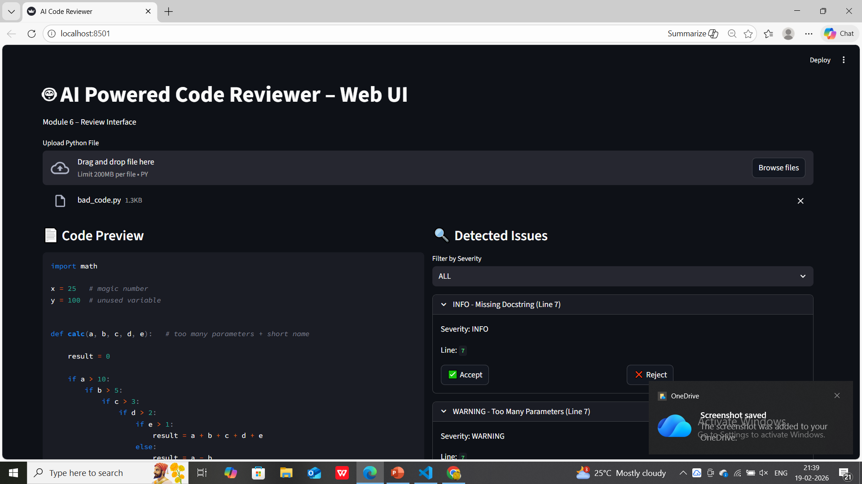
Frontend Interface
The frontend is built using Streamlit and provides a simple web interface.
Features:
Upload Python file
View complete code preview
See detected issues
Filter by severity
Accept or reject issues
View summary section
The summary displays total issues, critical issues, warnings, info, and final status.

Slide 9
Technologies Used
Backend:
Python
AST Module
CSV File Handling
Frontend:
Streamlit
Concepts:
Static Code Analysis
Cyclomatic Complexity
Rule-Based Evaluation
Code Quality Metrics

Slide 10
Advantages, Limitations & Future Scope
Advantages
Saves manual review time
Improves code quality
Easy to use
Automatic report generation
Limitations
Supports only Python
Performs only static analysis
Future Enhancements
AI-based smart suggestions
Multi-language support
GitHub integration
PDF report generation

Slide 11
Conclusion
The AI Powered Code Reviewer successfully automates Python code analysis.
It detects issues, measures complexity, assigns severity levels, calculates score, and generates a final report through an interactive web interface.
This system helps developers write cleaner, more maintainable, and high-quality code efficiently.
THANK YOU

